Slide 1


Rethinking LLM Evaluation
Ion Stoica
(joint work with: Lianmin Zheng, Ying Sheng, Wei-Lin Chiang, Dacheng Li, Zhuohan Li, Zi Lin, Zhanghao Wu, Shuo Yang, Siyuan Zhuang, Yonghao Zhuang, Joseph E. Gonzalez, Eric P. Xing
August 27, 2023
Notes:
Hi, my name is Ion Stoica and I am a faculty at UC Berkeley, and the director of the RISELab.

Slide 2

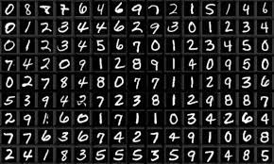

“For better or worse, benchmarks shape a field”
- David Patterson, Turing Award 2017

Slide 3
LLMs extremely hard to evaluate
Expensive
Unreliable

Slide 4
User
Develop a Python program that reads all the text files under a directory and returns top-5 words with the most number of occurrences

Slide 5
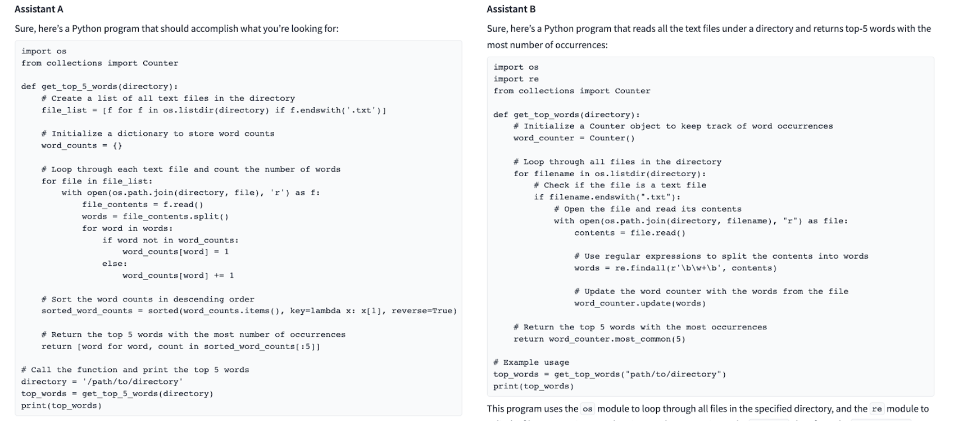
Expensive: Which one is better?
User
Develop a Python program that reads all the text files under a directory and returns top-5 words with the most number of occurrences

Slide 6
User
Photosynthesis is a vital process for life on Earth. Could you outline the two main stages of photosynthesis, including where they take place within the chloroplast, and the primary inputs and outputs of each stage

Slide 7
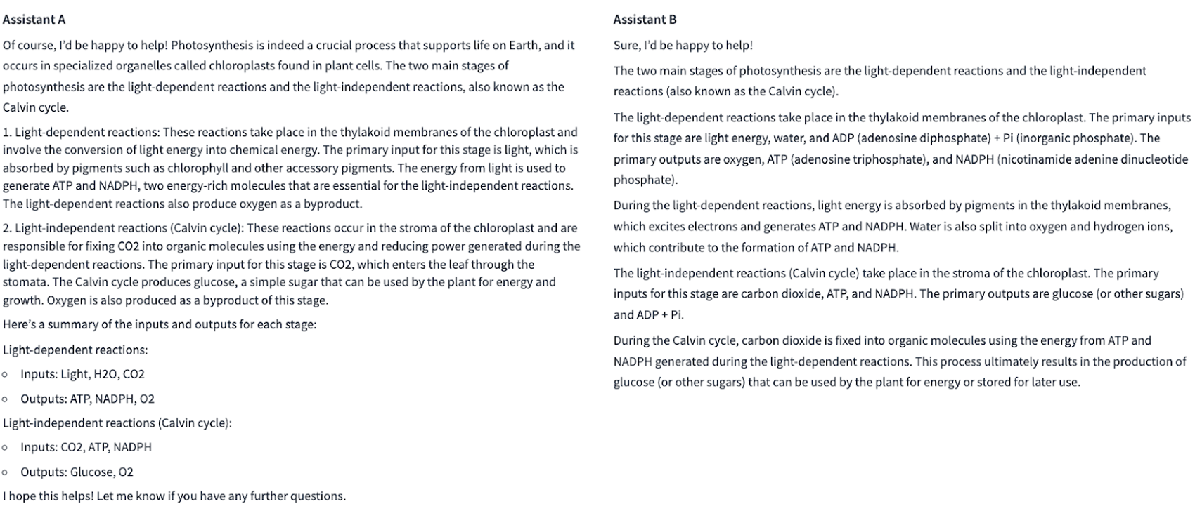
Expensive: Which one is better?
User
Photosynthesis is a vital process for life on Earth. Could you outline the two main stages pf photosynthesis, including where they take place within the chloroplast, and the primary inputs and outputs of each stage

Slide 8
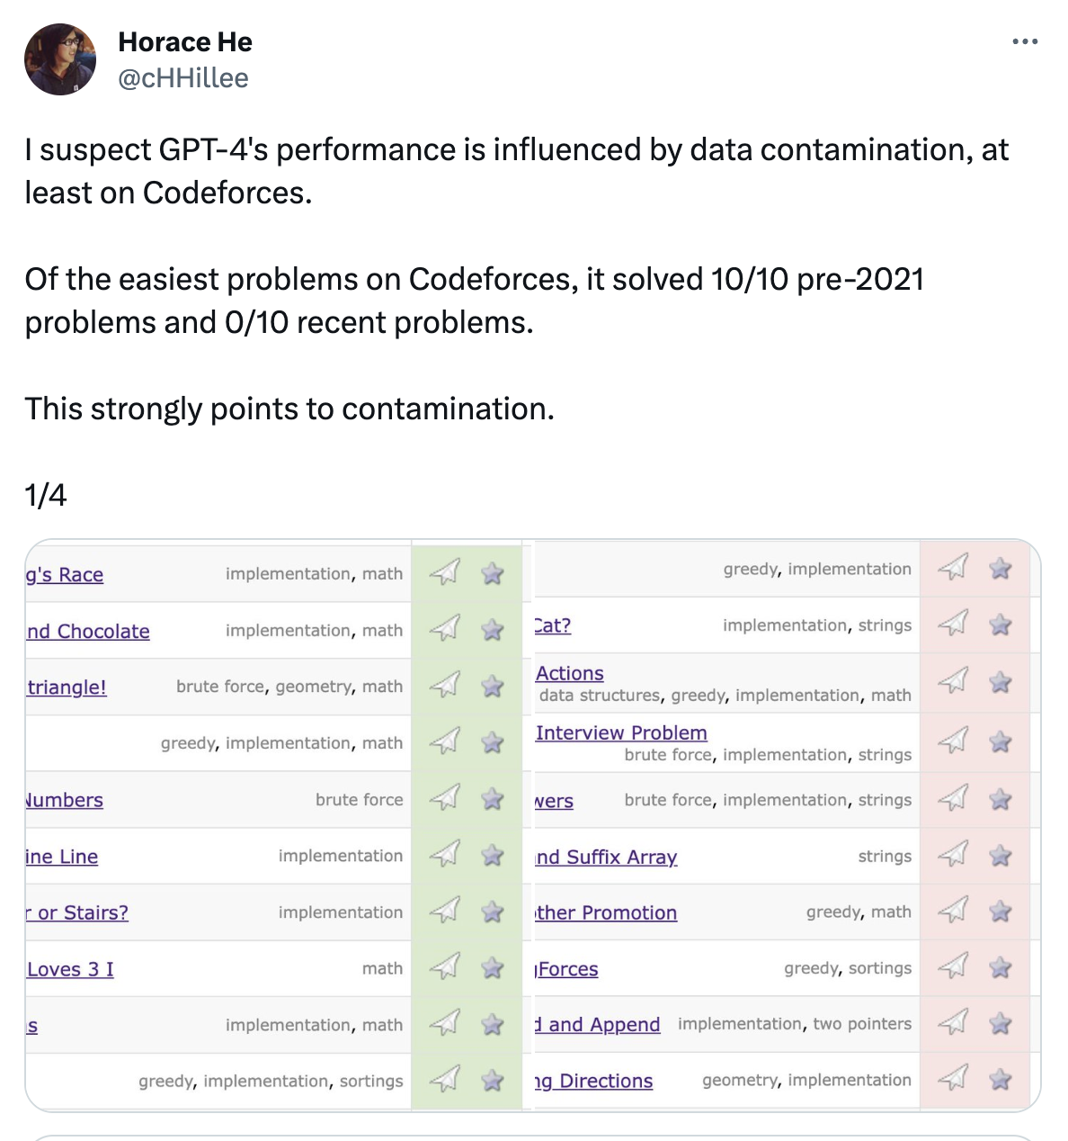
Unreliable: Data contamination

Slide 9
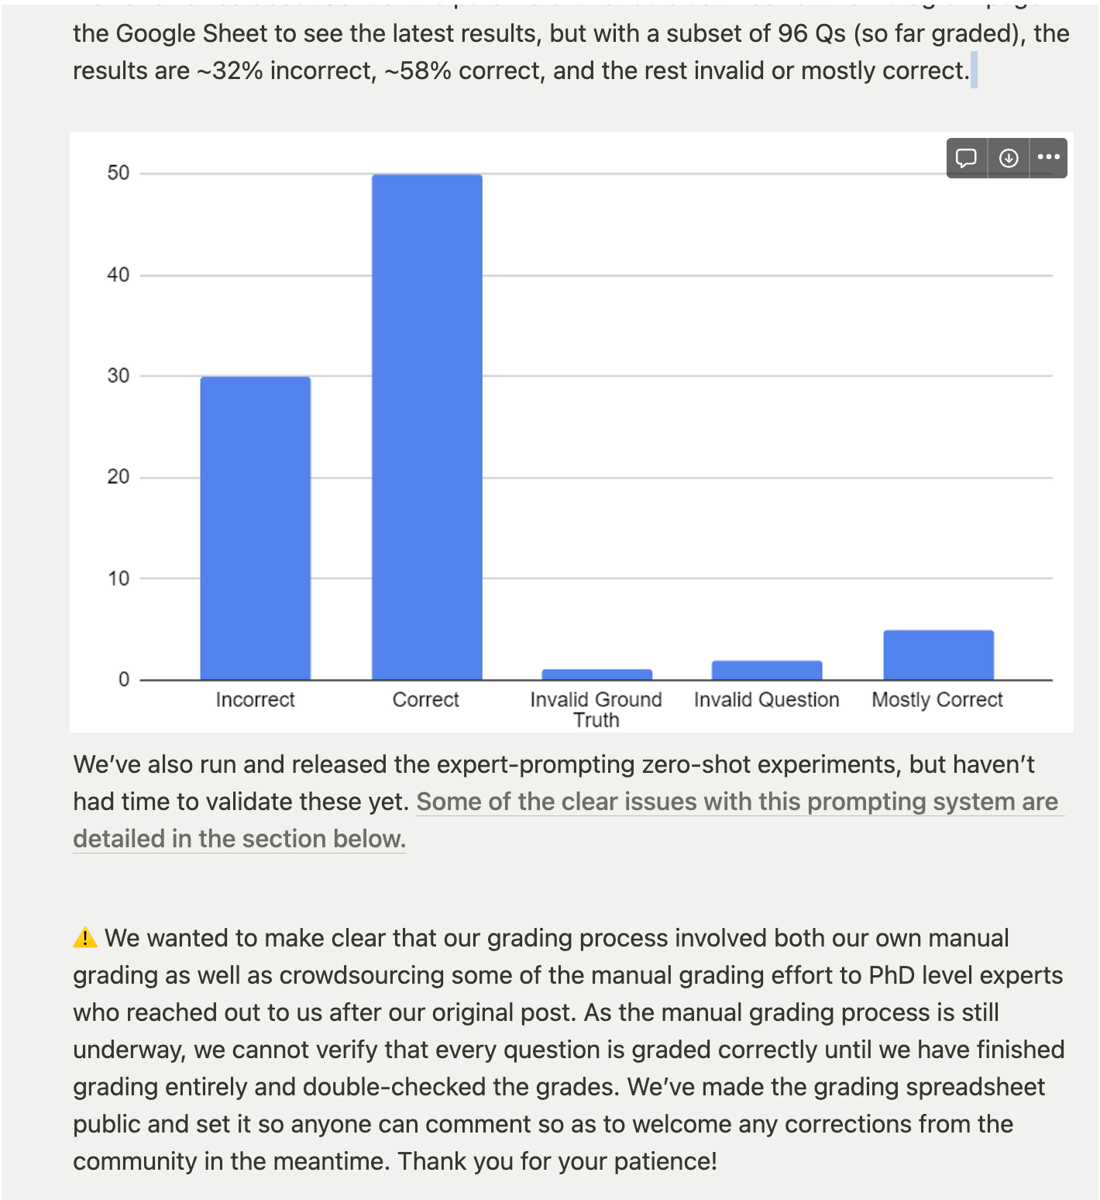
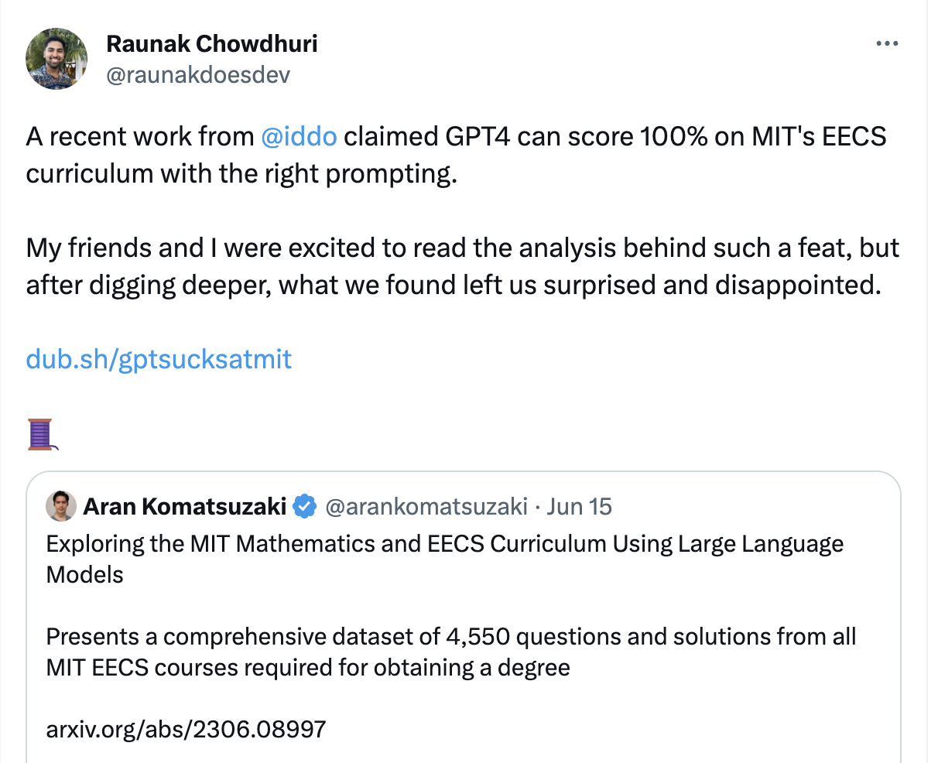

Unreliable: Data contamination

Slide 10


Our story
After Facebook released LLaMa in February 2023…
… we released Vicuna: fine tuned LLaMa using SharedGPT data (70K conversations)

Slide 11
How to evaluate it?
Humans take long and are expensive
We used GPT-4 (released 2 weeks earlier) for evaluation

Slide 12
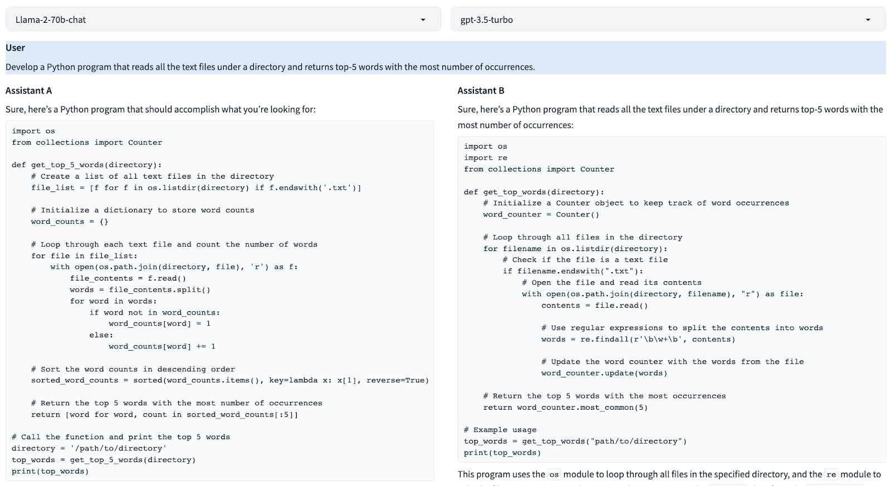
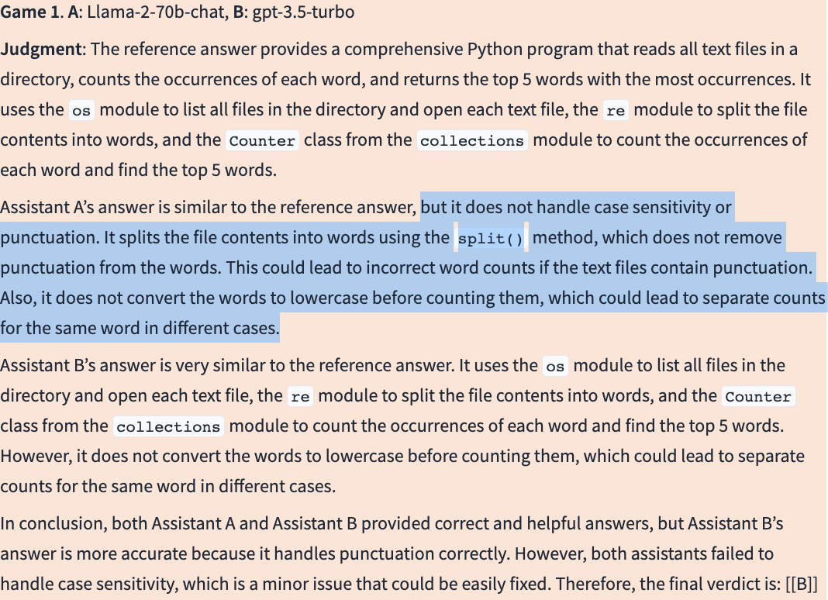
Which one is better?

Slide 13
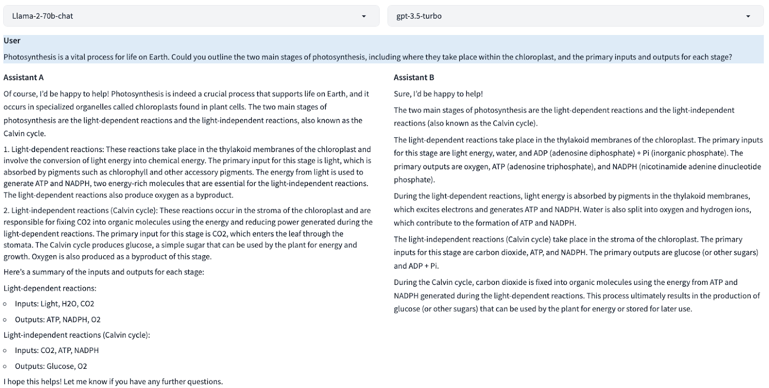
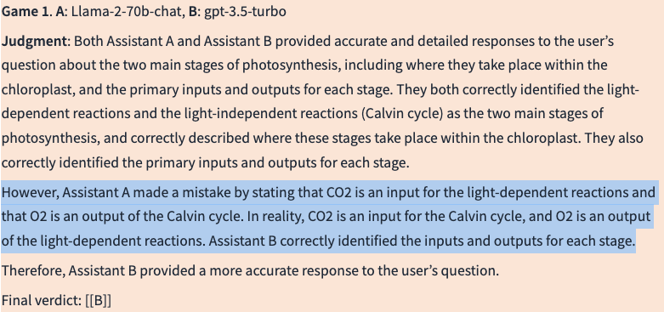
Which one is better?

Slide 14

Human evaluation
Chatbot answers interpreted by humans, so it makes sense humans to be ultimate arbiters
Ideally, for every question we want to rank all LLMs
Ranking N choices is hard:
Easier to pick best of N
Even easier to pick best of two!
Pick the best answer between two LLMs

Slide 15

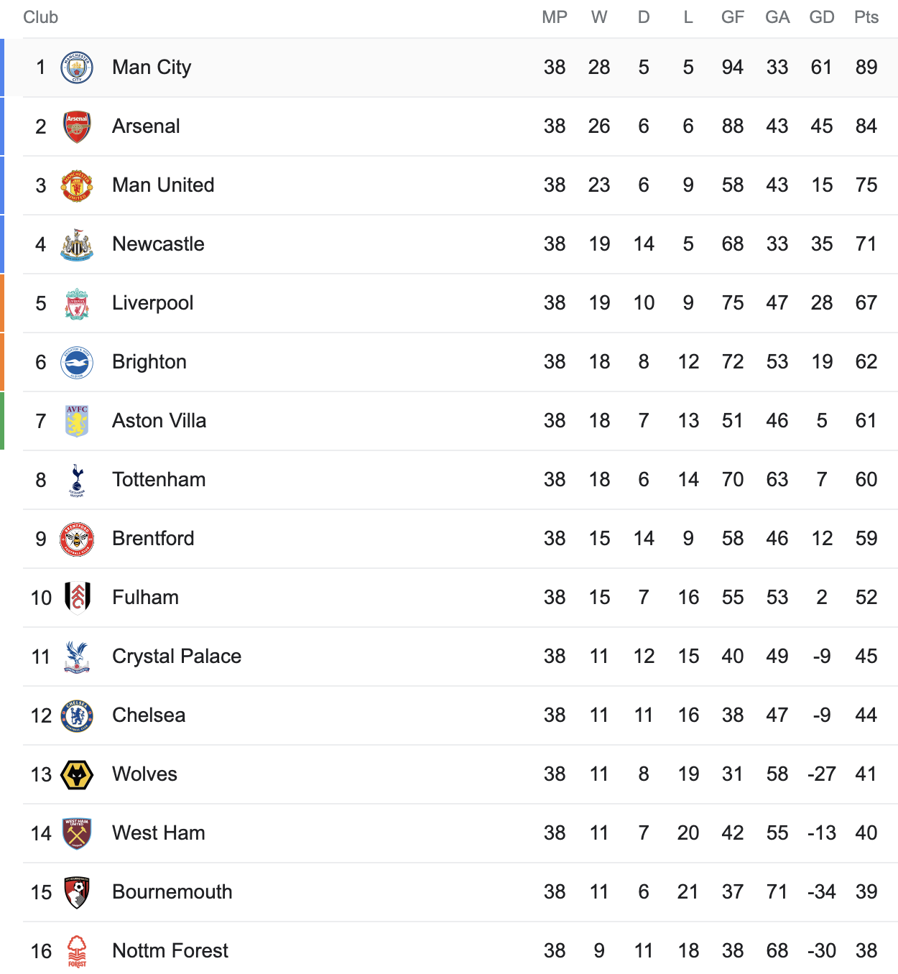
Human evaluation
Tournament: for each question, compare each pair of LLMs
Hard to scale

Slide 16

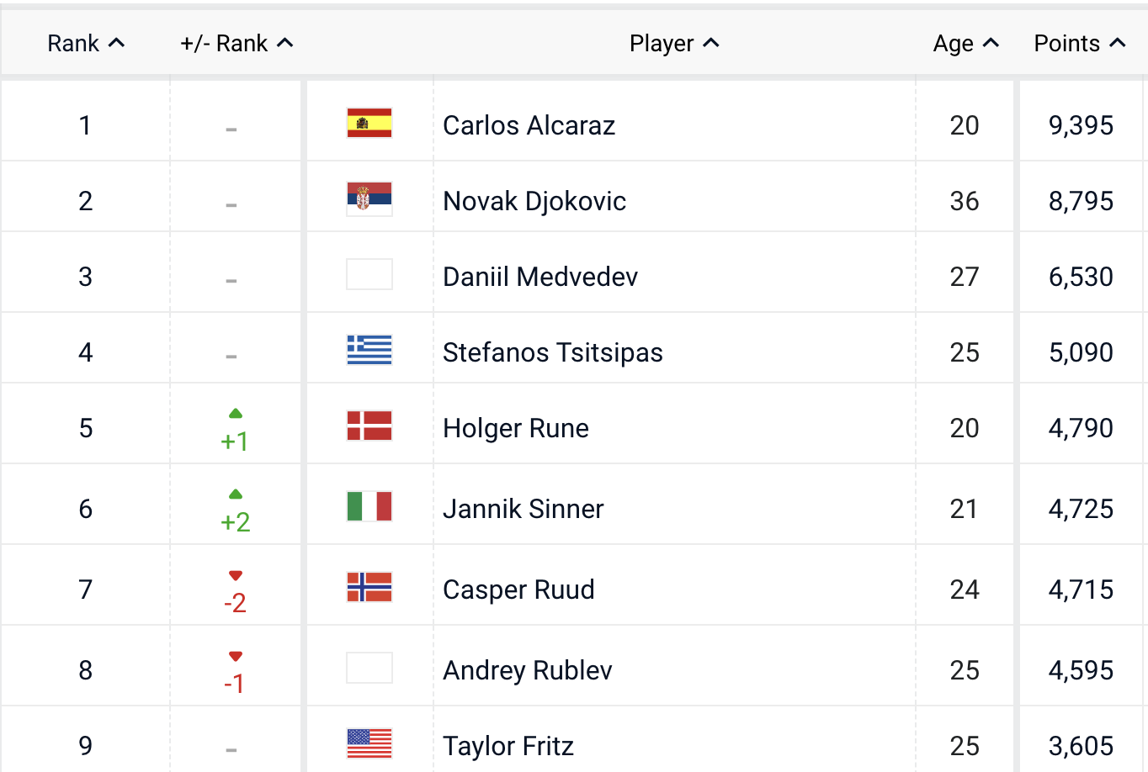
How to scale human evaluation?
Tournament → expensive
Rating
We use ELO rating

Slide 17
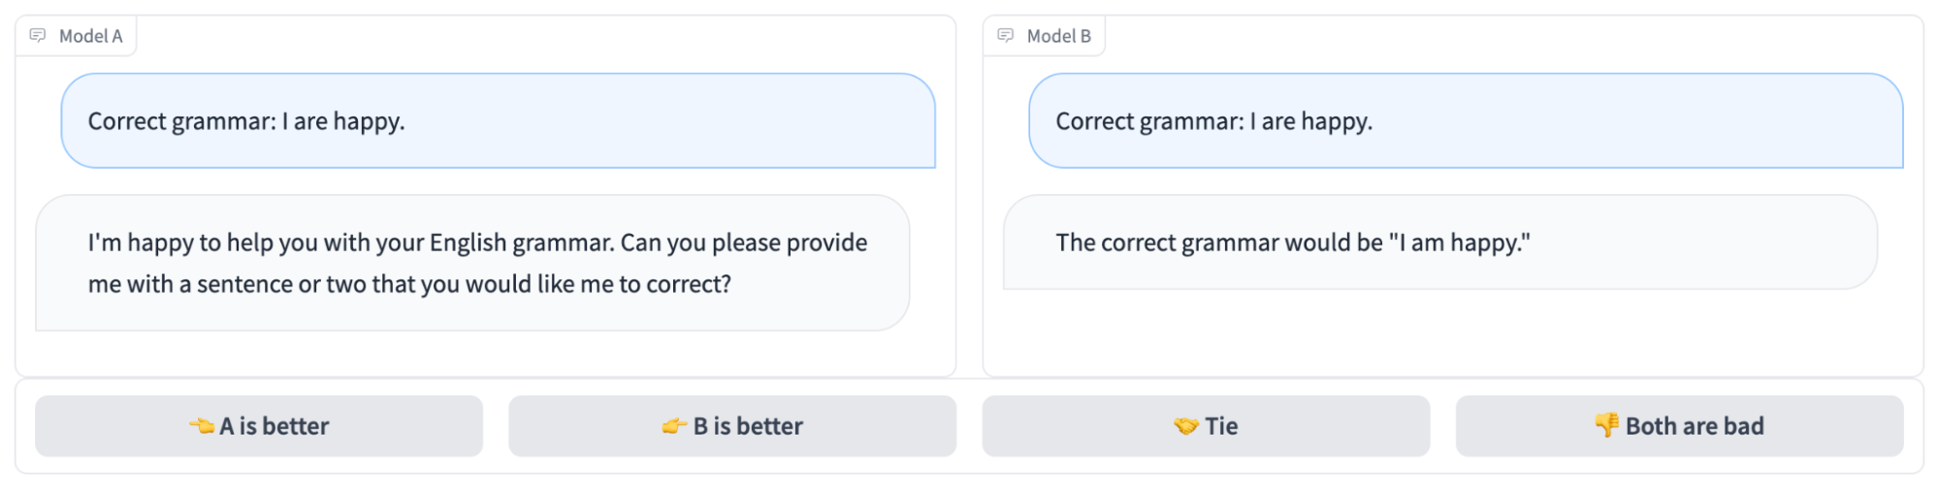
Chatbot arena: Benchmarking LLMs in the Wild
Benchmark platform for LLMs that features anonymous, randomized battles in a crowdsourced manner
https://arena.lmsys.org

Slide 18
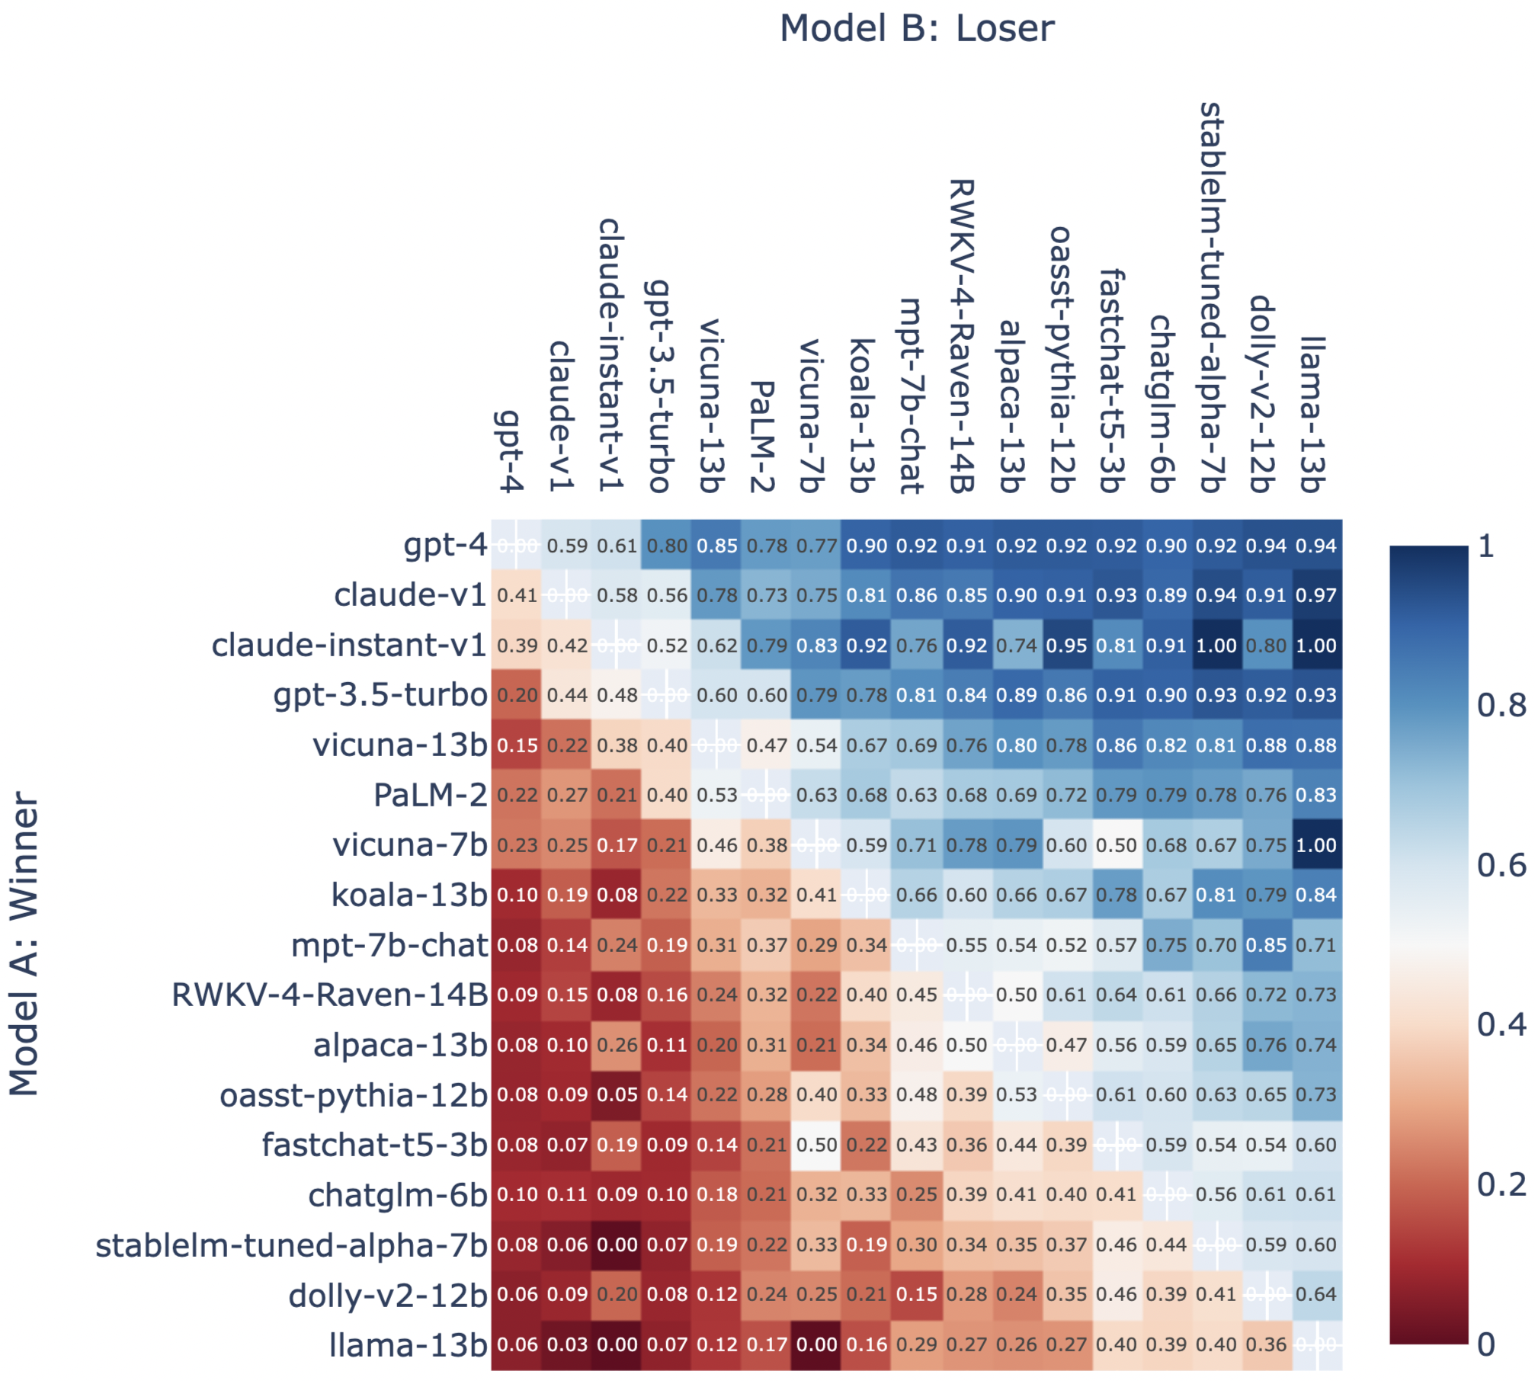
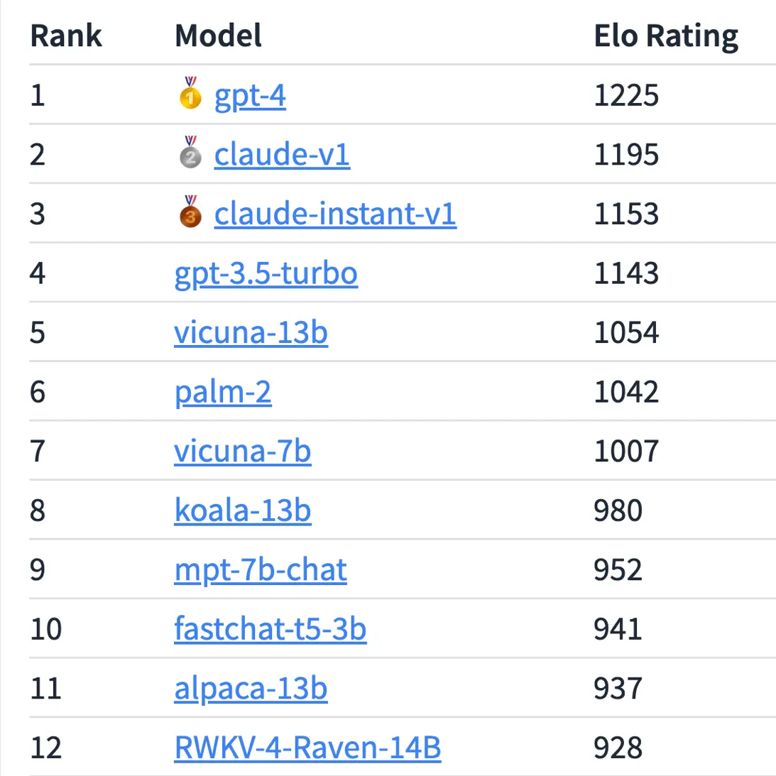
Chatbot Arena: Results
Elo ratings Based on 27K user votes
Win rate between model pairs
https://chat.lmsys.org/?compare

Slide 19
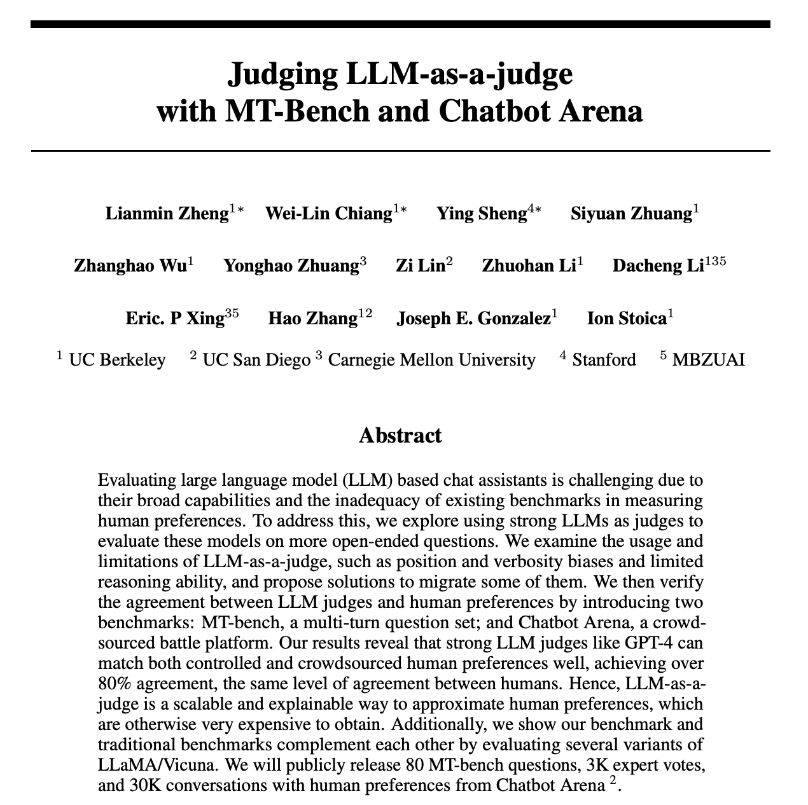
Can we really trust an LLM as a Judge
Systematic study: https://arxiv.org/pdf/2306.05685.pdf

Slide 20
Limitations: not unlike humans!
Position bias: prefer first position
Verbosity bias: prefer long answers
Self-enhancement bias: prefer answers from itself
Limited reasoning: not good at grading math questions

Slide 21
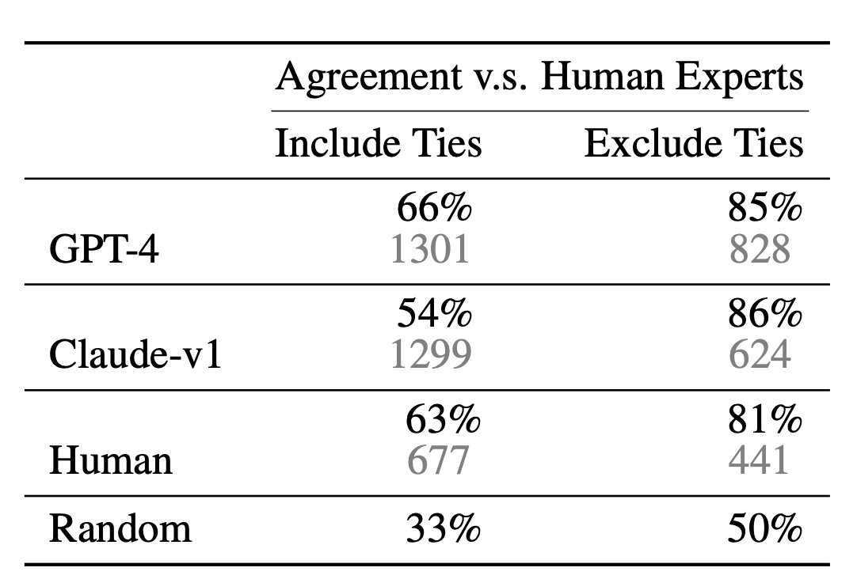
High agreement despite limitations
Agreement between GPT-4 and humans over 80%: same as human-human agreement

Slide 22



What about data contamination?
Steal a page on how humans are evaluated!
One-time exams: each exam is different
Collaborating with

Slide 23
Summary
LLM evaluation extremely hard
Cracking this problem requires new techniques
LLMs as judges
Scalable human evaluation
Many challenges remain
Contamination: generating unique exams difficult
Diversity: most questions are easy; need hard questions to differentiate between LLMs

